Slide 1
MATHEMATICAL FOUNDATION FOR COMPUTER SCIENCE
Prepared by: Er. Ankit Kharel
Nepal college of information technology

Slide 2
GRAPH THEORY

Slide 3
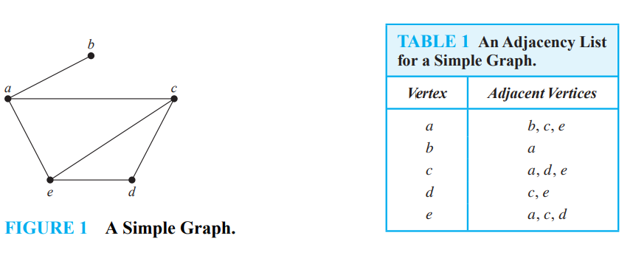
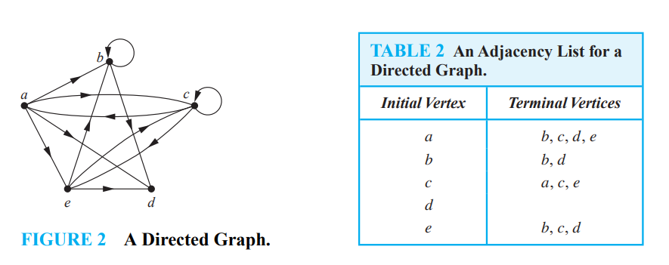
REPRESENTING GRAPHS:
Adjacency List:
One way to represent a graph is to use adjacency lists, which specify the vertices that are adjacent to each vertex of the graph

Slide 4
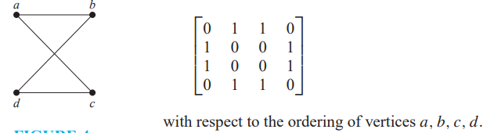
REPRESENTING GRAPHS:
2. Adjacency Matrix:
Suppose that G = (V , E) is a simple graph where |V| = n. Suppose that the vertices of G are listed arbitrarily as v₁, v₂,..., v_{n}. The adjacency matrix A (or AG) of G, with respect to this listing of the vertices, is the n x n zero–one matrix with 1 as its (i, j )th entry when v_{i} and v_{j} are adjacent, and 0 as its (i, j )th entry when they are not adjacent. In other words, if its adjacency matrix is A = [a_{ij} ], then
a_{ij} =
1 if {vi, vj } is an edge of G, 0 otherwise.

Slide 5
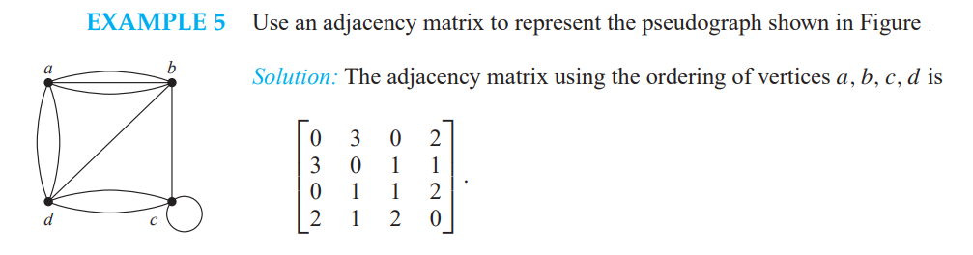
REPRESENTING GRAPHS:
Adjacency matrices can also be used to represent undirected graphs with loops and with multiple edges. When multiple edges connecting the same pair of vertices vi and vj , or multiple loops at the same vertex, are present, the adjacency matrix is no longer a zero–one matrix, because the (i, j )th entry of this matrix equals the number of edges that are associated to {vi, vj }. All undirected graphs, including multigraphs and pseudo graphs, have symmetric adjacency matrices.

Slide 6
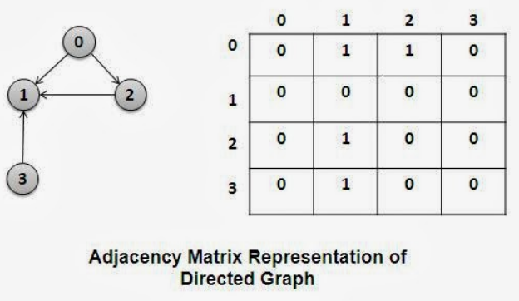
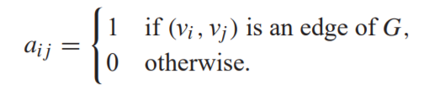
REPRESENTING GRAPHS:
The matrix for a directed graph G = (V , E) has a 1 in its (i, j )th position if there is an edge from vi to vj , where v1, v2,..., vn is an arbitrary listing of the vertices of the directed graph. In other words, if A = [aij ] is the adjacency matrix for the directed graph with respect to this listing of the vertices, then
The adjacency matrix for a directed graph does not have to be symmetric, because there may not be an edge from vj to vi when there is an edge from vi to vj .

Slide 7
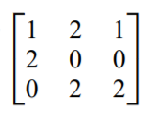
REPRESENTING GRAPHS:
Draw the graph represented by the given adjacency matrix.
Since the matrix is not symmetric, we need directed edges.

Slide 8
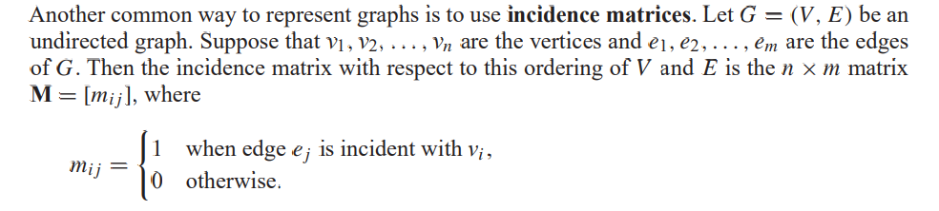
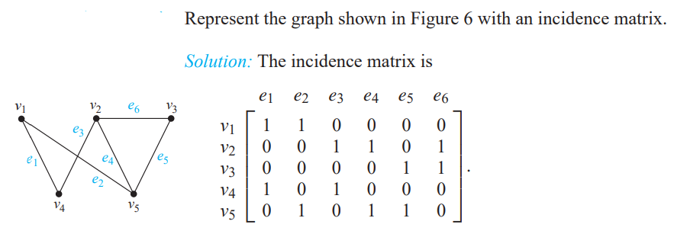
REPRESENTING GRAPHS:
3. Incidence Matrices:

Slide 9
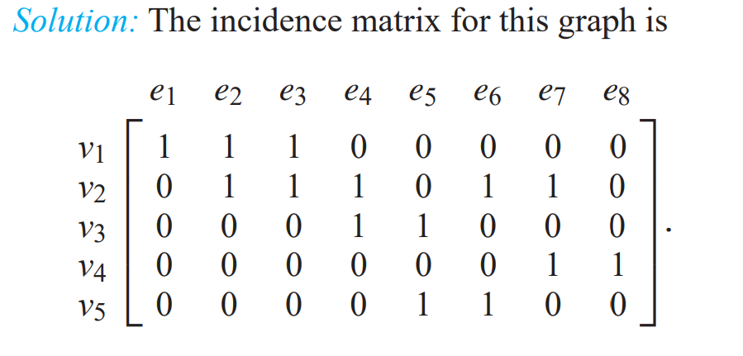
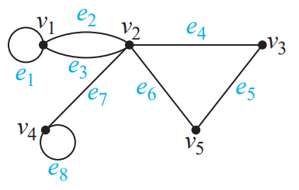
REPRESENTING GRAPHS:
3. Incidence Matrices:

Slide 10
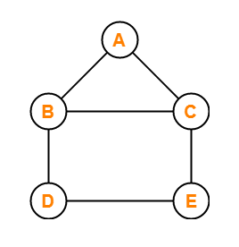
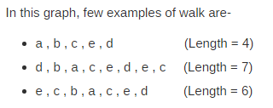
CONNECTIVITY:
Connectivity is a basic concept of graph theory. It defines whether a graph is connected or disconnected. Without connectivity, it is not possible to traverse a graph from one vertex to another vertex.
WALK: A walk is defined as a finite alternating sequence of vertices and edges, beginning and ending with vertices such that each edge is incident with the vertices preceding and following it.
Open Walk: a walk is called as an Open walk if Length of the walk is greater than zero and the vertices at which the walk starts and ends are different.
Closed Walk: a walk is called as an Closed walk if Length of the walk is greater than zero and the vertices at which the walk starts and ends are same.
If length of walk i= 0, then it is called as a Trivial Walk
Both vertices and edges can repeat in a walk whether it is an open walk or a closed walk.

Slide 11
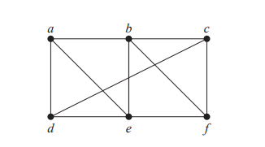
CONNECTIVITY:
TRIAL: A trail is defined as an open walk in which Vertices may repeat but edges are not allowed to repeat.
CIRCUIT: A circuit is defined as a closed walk in which Vertices may repeat but edges are not allowed to repeat.(Closed trial)
4. PATH: A path is defined as an open walk in which neither vertices are allowed to repeat nor edges are allowed to repeat.
5. CYCLE: A cycle is defined as a closed walk in which neither vertices (except possibly the starting and ending vertices) are allowed to repeat nor edges are allowed to repeat.(Closed Path)

Slide 12
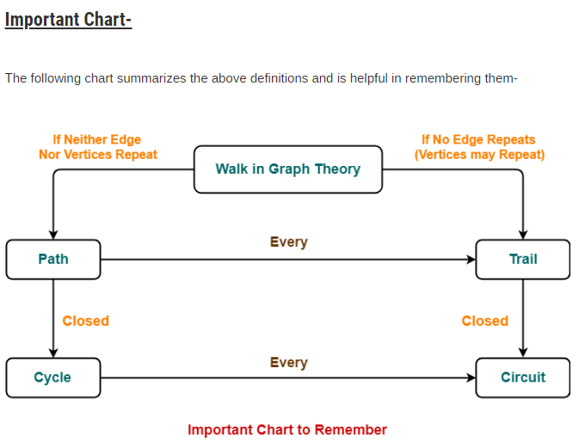

Slide 13
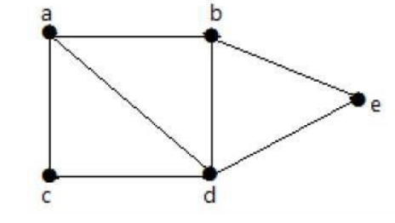
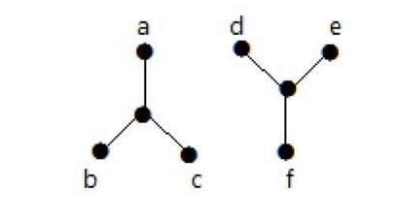
CONNECTEDNESS IN UNDIRECTED GRAPHS:
A graph is said to be connected if there is a path between every pair of vertex. From every vertex to any other vertex, there should be some path to traverse. That is called the connectivity of a graph
Example 1
In the following graph, it is possible to travel from one vertex to any other vertex. For example, one can traverse from vertex ‘a’ to vertex ‘e’ using the path ‘a-b-e’.
Example 2
In the following example, traversing from vertex ‘a’ to vertex ‘f’ is not possible because there is no path between them directly or indirectly. Hence it is a disconnected graph.

Slide 14
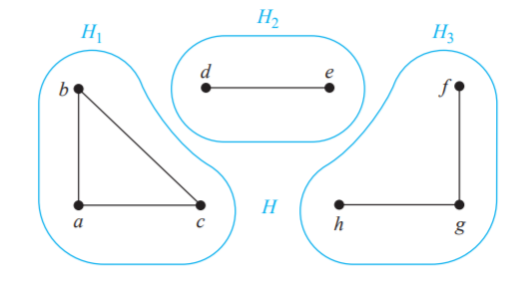
CONNECTEDNESS IN UNDIRECTED GRAPHS:
CONNECTED COMPONENTS: A connected component of a graph G is a maximal connected subgraph of G.
What are the connected components of the graph H shown in below figure?
Solution:
The graph H is the union of three disjoint connected subgraphs H1, H2, and H3, shown in Figure. These three subgraphs are the connected components of H.

Slide 15
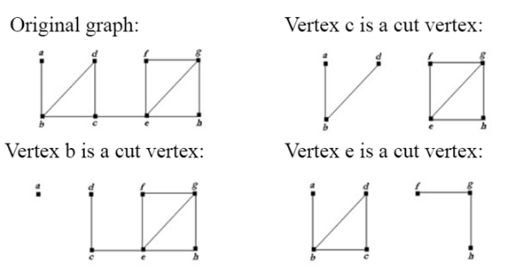
CONNECTEDNESS IN UNDIRECTED GRAPHS:
CUT VERTICES: Sometimes the removal from a graph of a vertex and all incident edges produces a subgraph with more connected components or disconnects the Graph. Such vertices are called cut vertices(or articulation points).
CUT EDGES: Analogously, an edge whose removal produces a graph with more connected components than in the original graph is called a cut edge or bridge. A cut edge 'e' must not be the part of any cycle in G.
Find the cut vertices and cut edges in the graph G shown in above Figure.
Solution:
The cut vertices of G are b, c, and e. The removal of one of these vertices (and its adjacent edges) disconnects the graph.
The cut edges are {a, b} and {c, e}. Removing either one of these edges disconnects G.

Slide 16
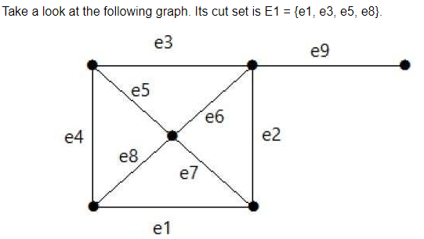
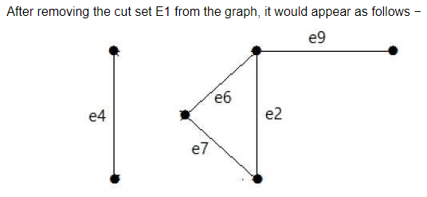
CONNECTEDNESS IN UNDIRECTED GRAPHS:
3. Cut Set of a Graph: Let ‘G’= (V, E) be a connected graph. A subset E’ of E is called a cut edge set of G if deletion of all the edges of E’ from G makes G disconnect. A subset V’ of V is called a cut vertex set of G if deletion of all the vertex of V’ from G makes G disconnect.
Similarly there are other cut sets that can disconnect the graph-
E3 = {e9} – Smallest cut set of the graph.
E4 = {e3, e4, e5}
E5 = {e1, e7, e2}

Slide 17
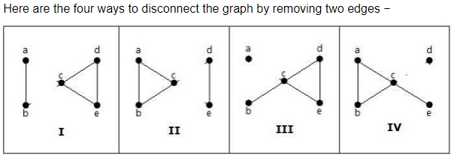
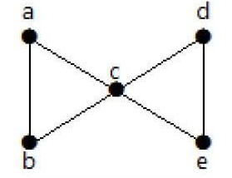
CONNECTEDNESS IN UNDIRECTED GRAPHS:
Not all graphs have cut vertices. For example, the complete graph K_{n}, where n ≥ 3, has no cut vertices. When you remove a vertex from K_{n} and all edges incident to it, the resulting subgraph is the complete graph K_{n−1}, a connected graph. Connected graphs without cut vertices are called non separable graphs.
Edge Connectivity: Let ‘G’ be a connected graph. The minimum number of edges whose removal makes ‘G’ disconnected is called edge connectivity of G.(minimum cut edge set of a graph)
Notation − λ(G)
Take a look at the following graph. By removing two minimum edges, the connected graph becomes disconnected. Hence, its edge connectivity (λ(G)) is 2. Therefore the above graph is a 2-edge-connected graph.

Slide 18
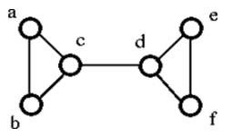
CONNECTEDNESS IN UNDIRECTED GRAPHS:
Vertex Connectivity: The connectivity (or vertex connectivity) of a connected graph G is the minimum number of vertices whose removal makes G disconnects or reduces to a trivial graph. To remove a vertex we must also remove the edges incident to it. (minimum cut vertex set of a graph)
Notation − K(G)
AN INEQUALITY FOR VERTEX CONNECTIVITY AND EDGE CONNECTIVITY
κ(G) ≤ λ(G) ≤ min_{v∈V} deg(v).
The above graph G can be disconnected by removal of the single vertex either 'c' or 'd'. Hence, its vertex connectivity, K(G) is 1. Therefore, it is a 1-connected graph.

Slide 19
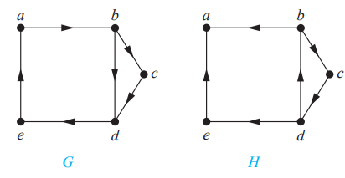
CONNECTEDNESS IN DIRECTED GRAPHS:
There are two notions of connectedness in directed graphs, depending on whether the directions of the edges are considered.
A directed graph is strongly connected if there is a path from a to b and from b to a whenever a and b are vertices in the graph.
A directed graph is weakly connected if there is a path between every two vertices in the underlying undirected graph
Graph G is strongly connected because there is a path between any two vertices in this directed graph.
The graph H is not strongly connected. There is no directed path from a to b in this graph. However, H is weakly connected, because there is a path between any two vertices in the underlying undirected graph of H

Slide 20
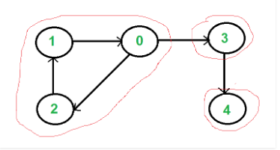
CONNECTEDNESS IN DIRECTED GRAPHS:
A strongly connected component (SCC) of a directed graph is a maximal strongly connected subgraph. For example, there are 3 SCCs in the following graph.

